Slide 1
Introduction
We have used Tokyo Olympic 2021 dataset. If we have some historical data, then we should have been able to show countries/individual sportsman performance in all Olympics.
Number of teams participated in a game to contest each other to win the medals.

Slide 2
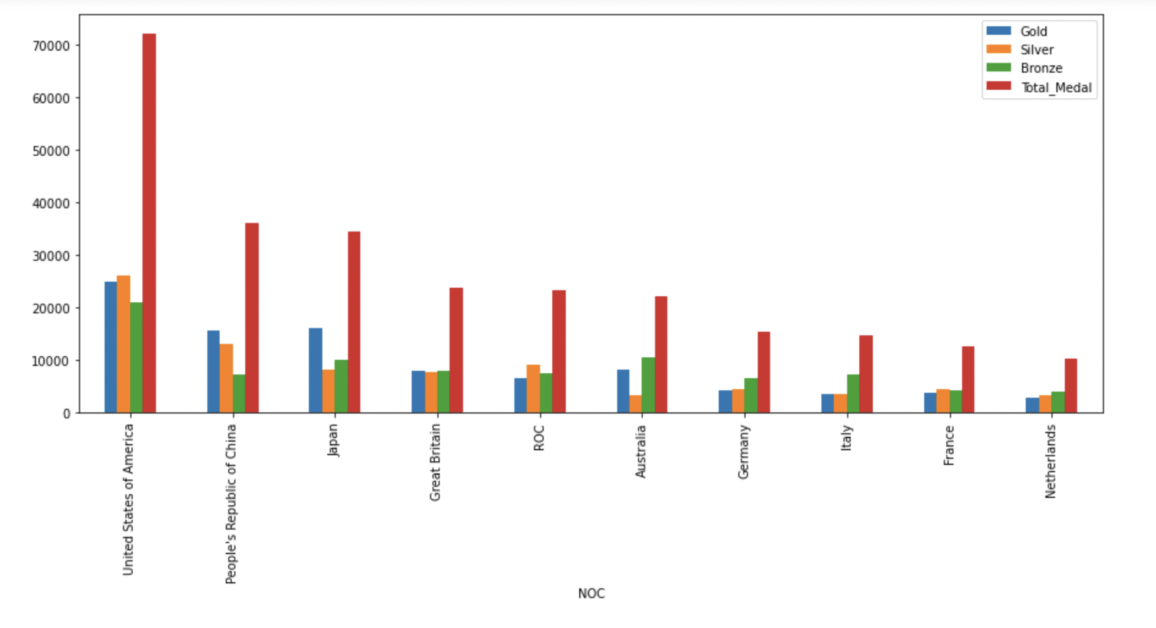
Bar Chart
Rank vs Country

Slide 3
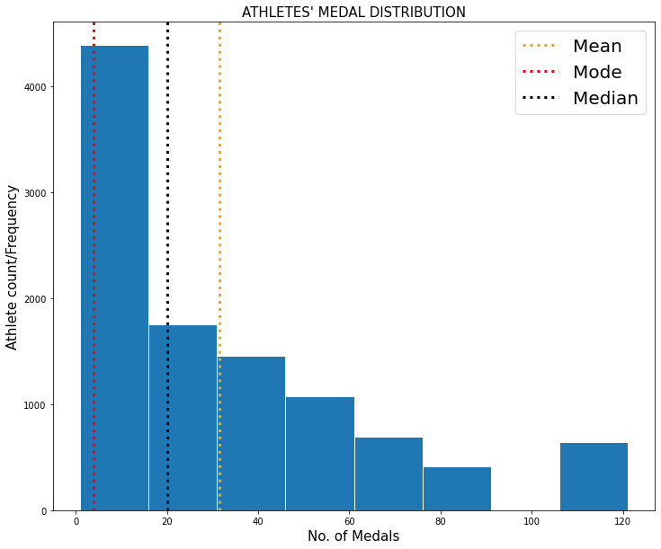
Histogram
The purpose of histogram is to graphically summarize the distribution of a univariate data set.
In this histogram, the distribution of total no. of medals won by athletes has been shown along with the average, most frequent and mid value of total medals won.
It summarizes to a rightly skewed histogram where the average number of medals won is greater than the mid value.

Slide 4
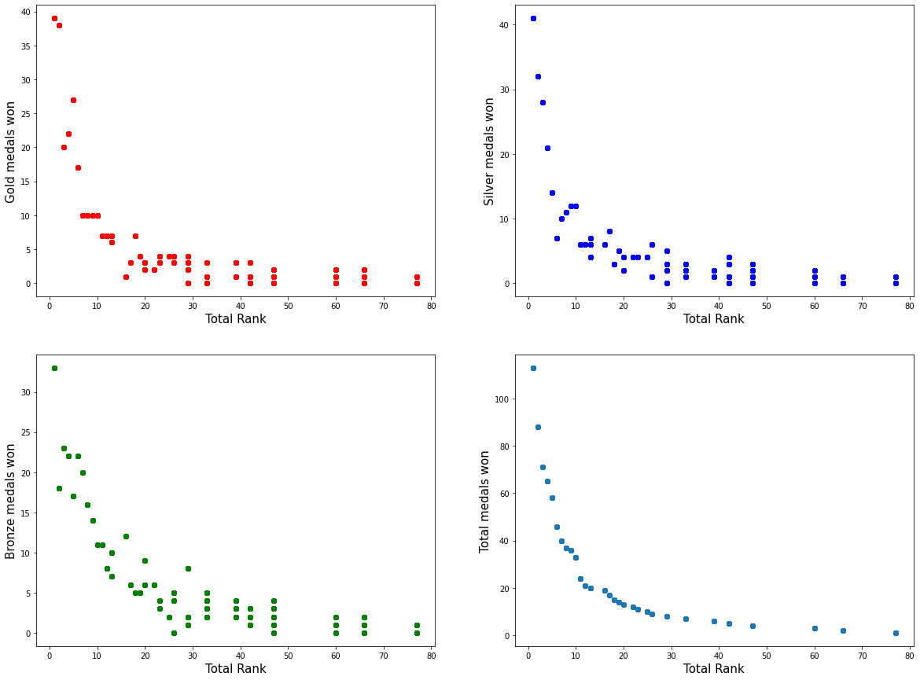
Scatter Plot
A scatterplot shows the relationship between two quantitative variables measured for the same individuals.
Based on the coefficient of correlation calculated, the no. of bronze medals won is highly correlated with the total rank scored.
These scatter plots show the correlation between the type of medals won by a team with their total rank.

Slide 5
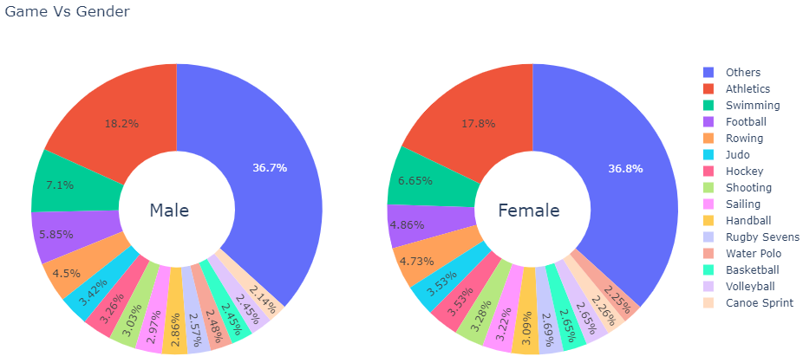
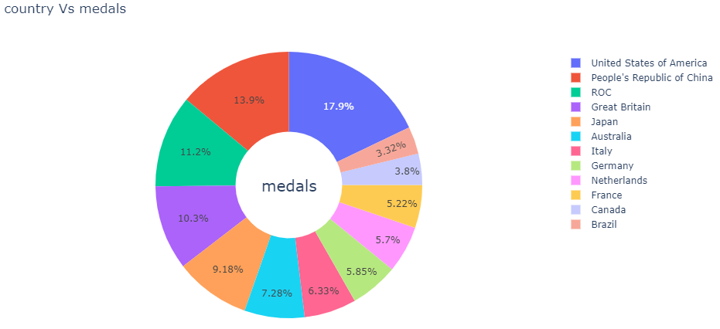
Pie Chart
Pie Charts help show proportions and percentages between categories, by dividing a circle into proportional segments.
In the below pie chart above we can observe the percentage participation of male and female against Game Discipline (data more the 2%).
In the pie chart below we can observe the percentage of total medals won by different counties.

Slide 6
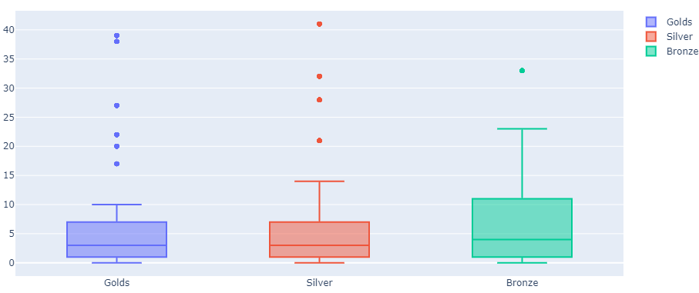
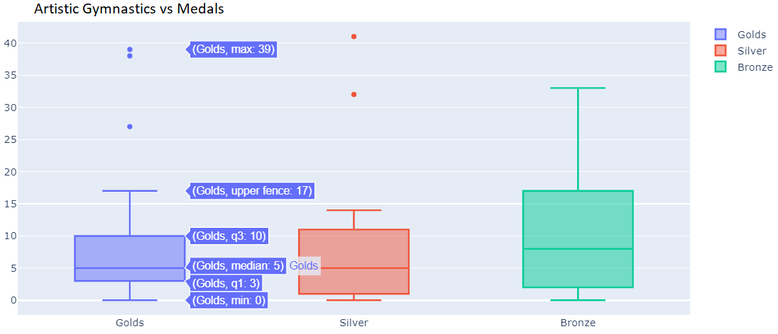
Boxplot
Box plots are used to show a distribution of values. And also the skewness of (distribution away from mean value).
In the above boxplot we can observe the spread of 3 different types of medals with respect the game discipline.
In the boxplot below we can observe the spread of 3 different medals for Artistic Gymnastics.

Slide 7
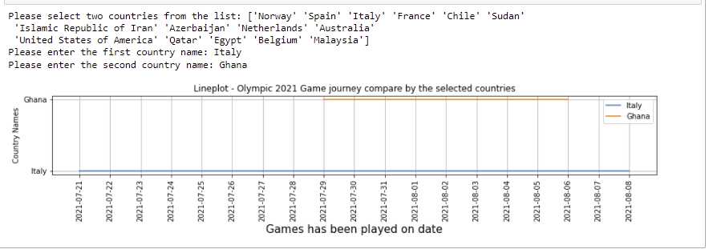
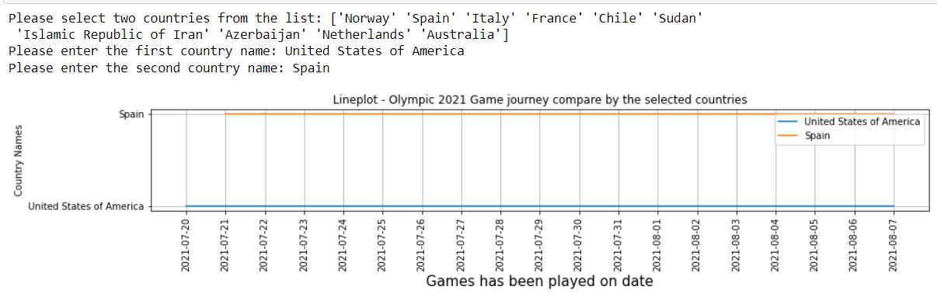
Lineplot
Lineplots are frequently used to show how some value changes over time.
In this lineplot user can select two different countries and visualize their Olympic journey.
In a sense that if the first country has finished their Olympic journey earlier than the second country then lineplot of the second country will be extended than the first country.

Slide 8
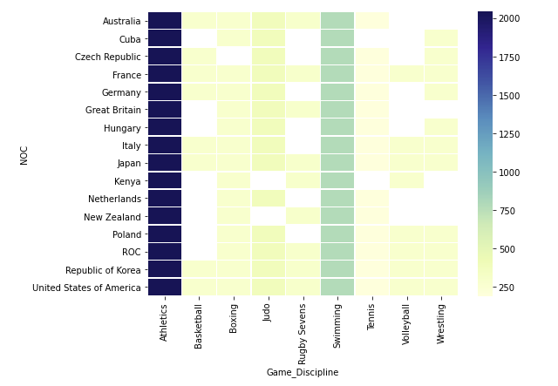
Heatmap
The heatmap is a way of representing the data in a 2-dimensional form. Here the values take a form of color to represent the data intensity.
Below Heatmap data visualization is to show the distribution of countries(NOC), the participated games and total number of participants.

Slide 9
Conclusion
Athletes and swimming is one of the most popular games and number of participants are high whereas Surfing has less participants.
Countries like USA, China and Japan is on the top whereas Ghana and Kuwait is in the bottom of the list.
For the top 5 popular games (swimming,Athletics,Rowing,Football,judo)the percentage of male participants is more compared to female participants.

Slide 10
Conclusion
Athletes and swimming is one of the most popular games and number of participants are high whereas Surfing has less participants.
Countries like USA, China and Japan is on the top whereas Ghana and Kuwait is in the bottom of the list.
For the top 5 popular games (swimming, Athletics, Rowing, Football, judo)the percentage of male participants is more compared to female participants.

Slide 11
Recommendation
We have used Olympic dataset of 1 year. If we have some historical data, then we should have been able to show countries/individual sportsman performance in all Olympics.
Number of teams participated in a game to contest each other to win the medals.

